Slide 1
Forest Service Review
Guam 2019
Aubrey Moore
Entomologist
University of Guam
Grant Project: Radio Tracking Rhino Beetles
Pacific Island Forestry Professional Workshop
Impact of Invasive Insects on Guam’s Dominant Trees
Change Analysis Using Forest Survey Data
Guam Biodiversity Inventory

Slide 2

Detector Dogs for Locating Breeding Sites

Slide 3
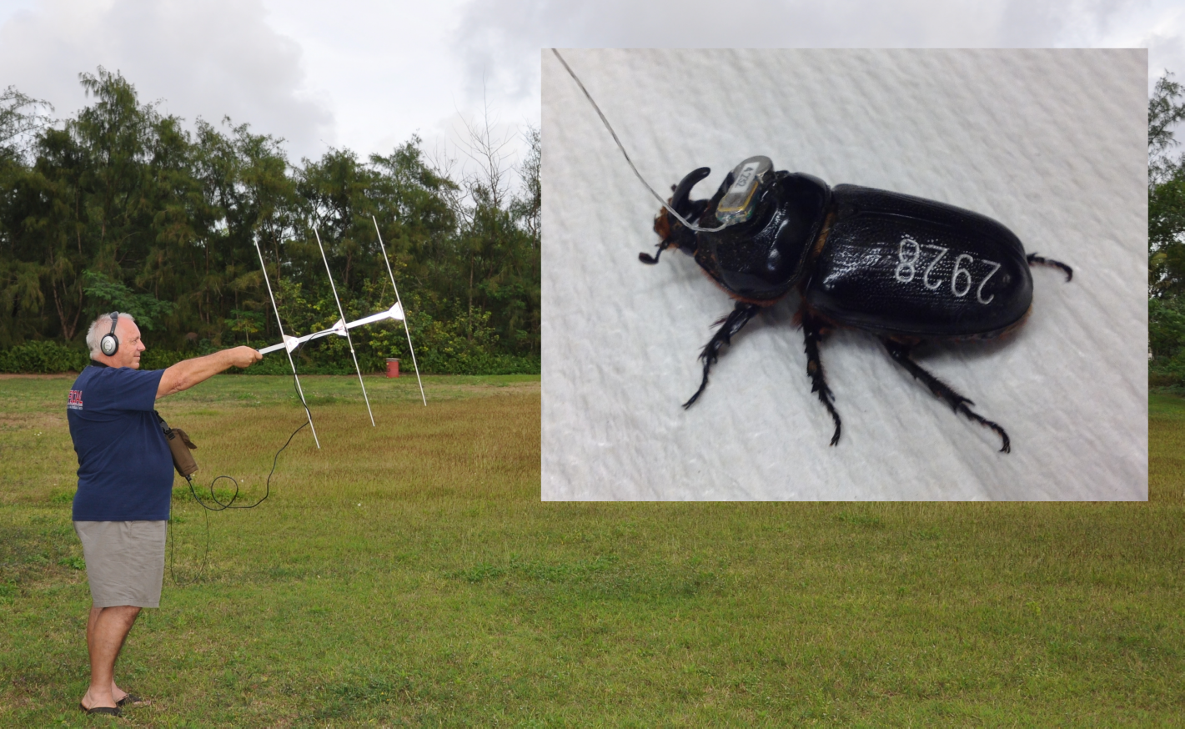
Detector Beetles for Locating Breeding Sites

Slide 4
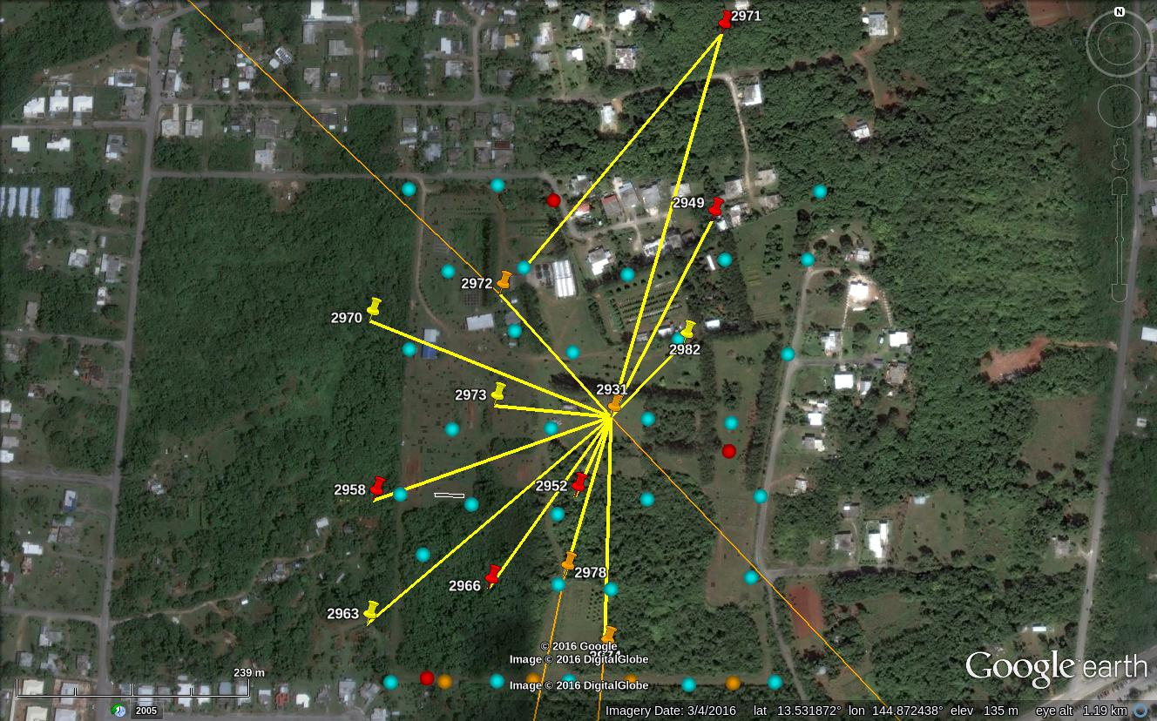
Detector Beetles for Locating Breeding Sites
Notes:
33 beetles were tagged and released at 2 sites
19 were successfully tracked to landing sites, 11 of which were considered to be active or potential breeding sites
The remaining 14 beetles were lost when they flew beyond the range of receivers.
Even though all beetles were released in the vicinity of barrel traps (blue dots on this figure) only one (out of 32) was trapped

Slide 5
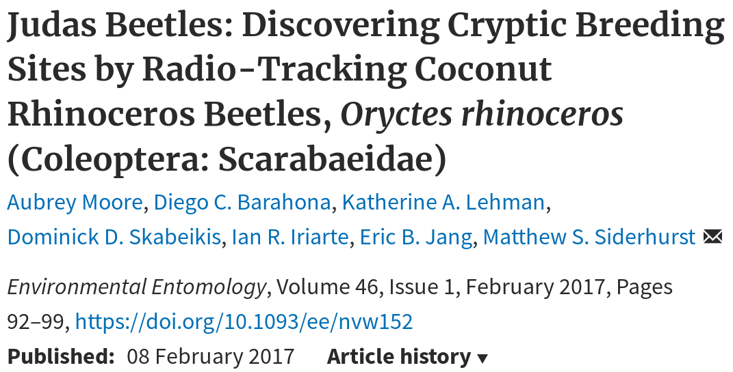

Slide 6
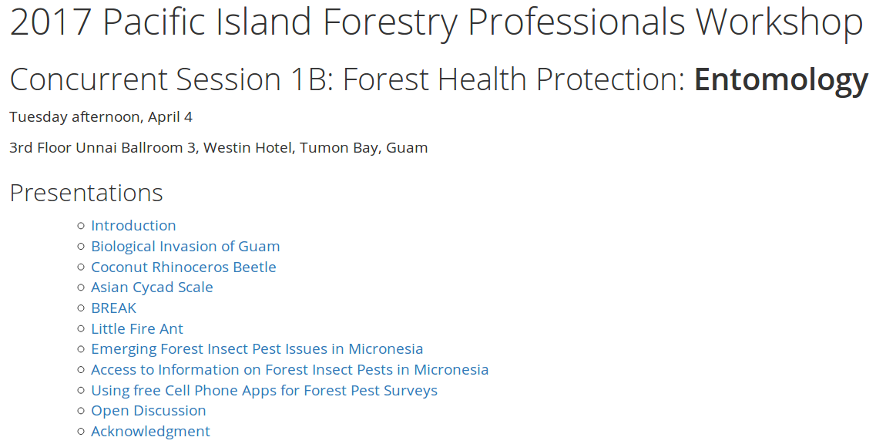
Moore, Aubrey. 2017. “Entomology Section for Pacific Island Forestry Meeting.” https://osf.io/a6t7v

Slide 7
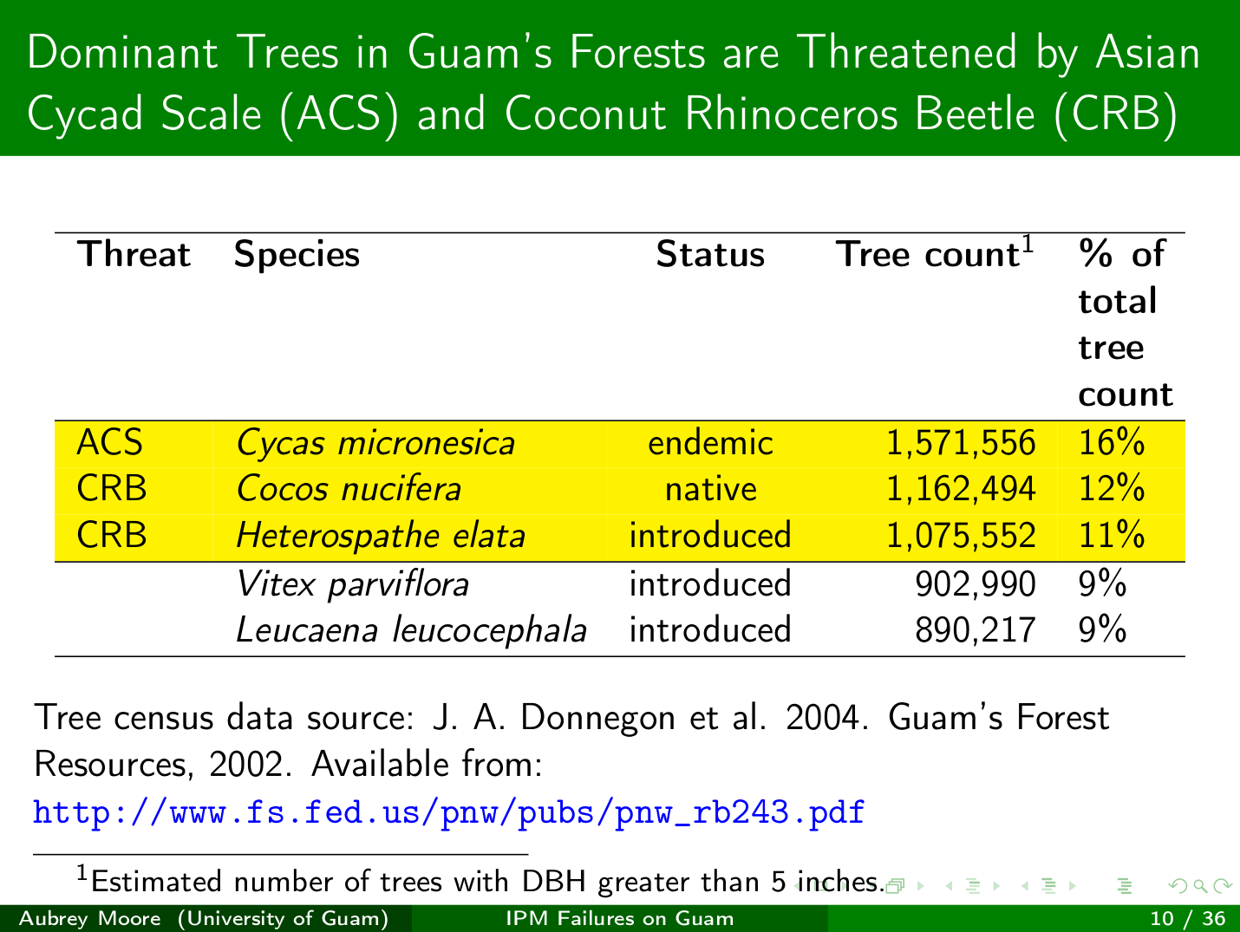
Moore, Aubrey. 2018. “Failed Attempts to Establish IPM for Asian Cycad Scale and Coconut Rhinoceros Beetle on Guam.” presented at the Annual Meeting of the Entomological Society of America, Vancouver, Canada, November 13. https://doi.org/10.5281/zenodo.2545065.

Slide 8
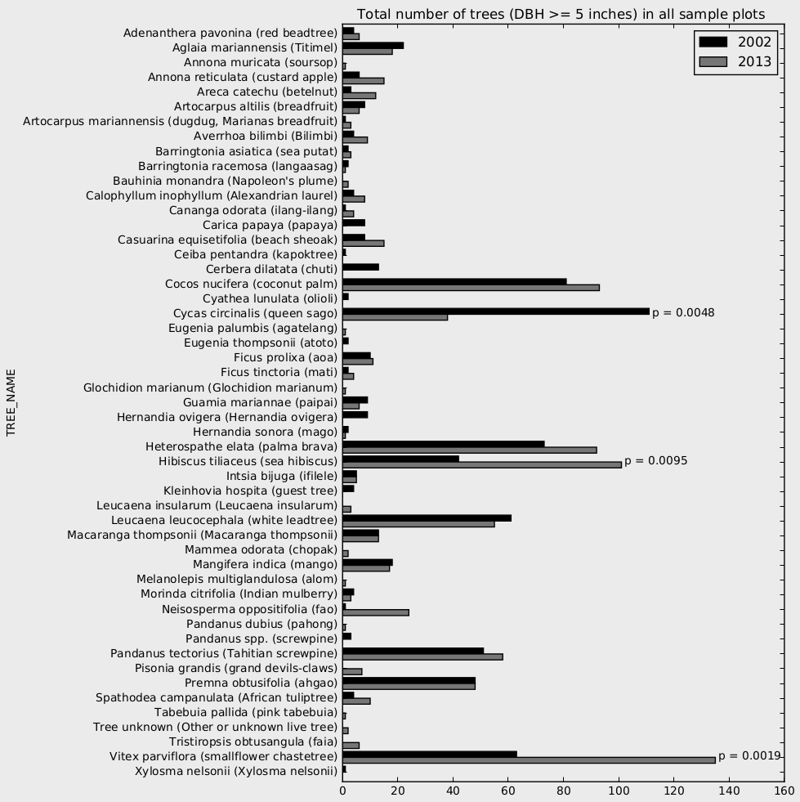
https://github.com/aubreymoore/SQLite-database-for-Guam-Forest-Inventory

Slide 9
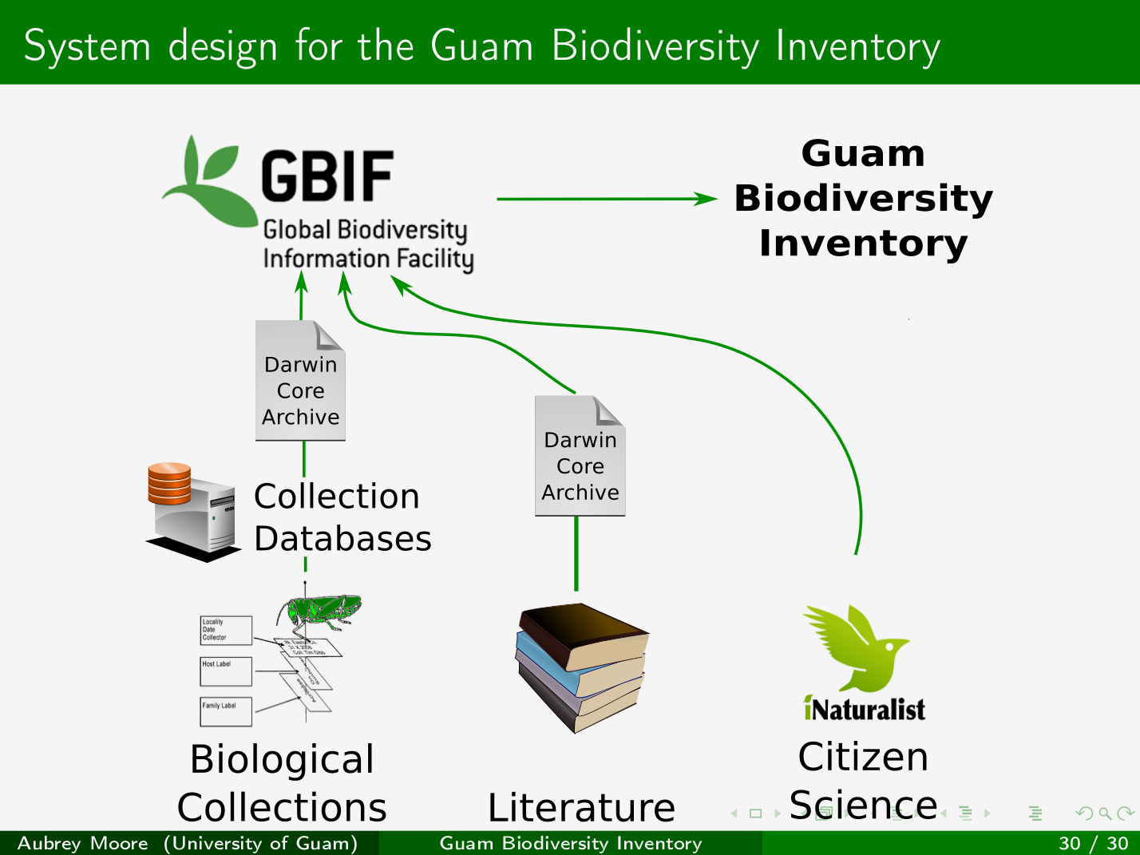
Moore, Aubrey. 2018. “Building a Terrestrial Biodiversity Inventory for Guam.” Oral presentation presented at the Second Annual Digital Data in Biodiversity Research Conference, Berkeley, CA. https://doi.org/10.6084/m9.figshare.6188315.v1.

